Slide 1
Analysis of Attack

Slide 2
Different Type of Attacks
Access Attacks
Modification and Repudiation Attacks
DoS Attacks
DDoS Attacks
Attacks on TCP
Attacks on UDP

Slide 3
Access Attacks
  Attempt to gain access to information that the attacker isn’t authorized to have
  Types of Access Attacks
    Eavesdropping
    Interception
    Spoofing
    Password Guessing Attacks
    Man-in-the-Middle Attacks

Slide 4
Eavesdropping
Process of listening in or overhearing parts of a conversation, this includes attackers listening in on your network traffic.
Passive attack
  Example: co-worker may overhear your dinner plans because your speaker phone is set too loud
Active attack
  Collecting data that passes between two systems on a network
Type of Eavesdropping:
    Inspecting the dumpster,
    Recycling bins,
    File cabinets for something interesting

Slide 5
Interception
Active Process
  Putting a computer system between the sender and receiver to capture information as it’s sent
Passive Process
  Someone who routinely monitors network traffic
Covert operation
Intercept missions can occur for years without the intercept party knowing

Slide 6
Spoofing
Attempt by someone or something to masquerade as someone else
Types of Spoofing:
  IP Spoofing
    Remote machine acts as a node on the local network to find vulnerabilities with your servers, and installs a backdoor program or Trojan horse to gain control over network resources
    Goal to make the data look like it came from a trusted
    host when it didn’t

Slide 7
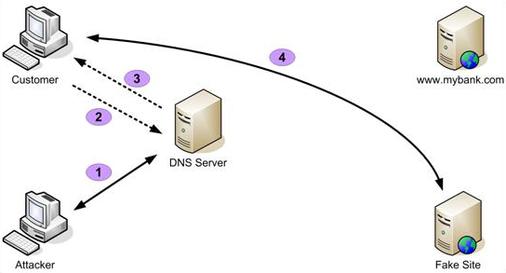
Spoofing (cont.)
DNS Spoofing
  DNS Server is given information about a name server that it thinks is legitimate, and can send users to websites other than the one they wanted to go to.

Slide 8
Password Guessing
When an account is attacked repeatedly
Accomplished by sending possible passwords to accounts in a systematic manner
Carried out to gain passwords for access or modification attack
Types of Password Guessing:
  Brute Force Attack
  Dictionary Attack

Slide 9
Brute Force and Dictionary Attacks
Brute Force
  Attempt to guess a password until a successful guess, occurs over long period of time
Dictionary
  Uses a dictionary of common words to attempt find a users password
  Can be automated

Slide 10
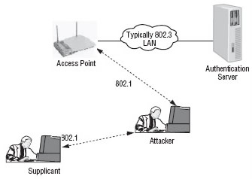
Man-in-the-Middle
Involves placing a piece of software between a server and user that they are aware of
Software intercepts data and then send the information to the server as if nothing is wrong
Attacker can save the data
or alter it before it reaches
its destination

Slide 11
Modification and Repudiation Attacks
Involves the deletion, insertion, or alteration of information in an unauthorized manner that is intended to appear genuine to the user.
Attacks may be used for:
  Planting information to set someone up
  Change class grades
  Alter credit card records
Types of Attacks
  Replay Attacks
  Back Door Attacks

Slide 12
Replay Attacks
Becoming quite common, and occurs when information is captured over a network
When logon and password information is sent over the network, attacker can capture it and replay it later
Also occurs for security certificates
  Attacker can resubmit the certificate, hopes of being validated by the authentication system
  Preventing that from happening is to have the certificate expire after you end your session

Slide 13
Back Door Attacks
Original term was referred to troubleshooting and developer hooks into the system, allowed programmers to examine operations inside the code
Other term refers to gaining access to a network and inserting a program that creates an entrance for an attacker
Back Orifice and NetBus are common tools to create a back door

Slide 14
Dos (Denial of Service) Attacks
Prevents access to resources by users that are authorized to use those resources
  These attacks can deny access to information, applications, systems, or communications
A DoS attack occurs from a single system and targets a specific server or organization
  Example of a DoS Attack is:
    Bringing down a e-commerce website

Slide 15
DoS Attacks (cont.)
Common types of DoS attacks are:
  TCP SYN Flood DoS Attacks
    open as many TCP sessions as possible to flood the network and take it offline
  Ping of Death
    Crashes a system by sending ICMP (Internet Control Message Protocol) packets that are larger than the system can handle
  Buffer Overflow
    Attempts to put more data, which would be long input strings, into the buffer than it can hold
    Code red, slapper and slammer are attacks that took advantage of buffer overflows

Slide 16
DDoS Attacks
DDoS (Distributed Denial of Service) is similar to a DoS attack, but amplifies the concepts by using multiple systems to conduct the attack against a specific organization
Attacks are controlled by a master computer
Attacker loads programs onto hundreds of normal computer users systems
When given a command, it triggers the affected systems and launches attack simultaneously on targeted network which could take it offline

Slide 17
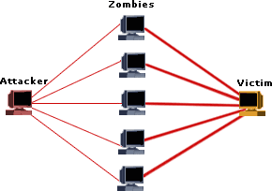
DDoS Attack (cont.)
Systems infected and controlled are known as zombies
Most OSes are susceptible to these attacks
There is little one can do to prevent
a DoS or DDoS attack

Slide 18
Attacks on TCP
(Transmission Control Protocol)
Type of Attacks on TCP:
  TCP SYN Flood Attack
  TCP Sequence Number Attack
  TCP Hijacking
  Sniffing the Network

Slide 19
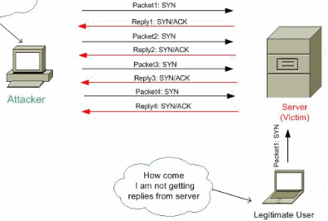
TCP SYN Flood Attack
Most common type, purpose
is to deny service
Client continually sends SYN
packets to the server and
doesn’t respond to the servers
SYN/ACK request, so
the server will hold these
sessions open waiting for the
client to respond with the ACK
packet in the sequence
This causes the server to
fill up available connections
and denies any requesting
clients access

Slide 20
TCP Sequence Number Attack
Attacker takes control of one end of a TCP session, in order to kick off the attacked end of the network for the duration of the session
Attacker intercepts and responds with a sequence number similar to one that the user was given
Attack can hijack or disrupt a session and gains connection and data from the legitimate system
Only defense of this attack is knowing that it is occurring

Slide 21
TCP Hijacking
Also called active sniffing
Involves the attacker gaining access to a host in the network and disconnecting it
Attacker then inserts another machine with the same IP address, which will allow the attacker access to all information on the original system
UDP and TCP don’t check the validity of an IP address which is why this attack is possible
Attack requires sophisticated software and are harder to engineer than DoS attack which is why these attacks are rare.

Slide 22
Sniffing the Network
Network sniffer device that captures and displays network traffic
All computers have the ability to operate as sniffers
Using the NIC card, it can be placed into promiscuous mode which will then allow the NIC card to capture all information that it sees on the network
Programs available to sniff the network, common one is wireshark

Slide 23
UDP Attacks
Attacks either the maintenance protocol or a service in order to overload services and initiate a DoS situation
Type of attacks on UDP (User Datagram Protocol):
  ICMP Attacks
  Smurf Attacks
  ICMP Tunneling

Slide 24
ICMP Attacks
Occurs by triggering a response from the ICMP protocol when it responds to a seemingly legitimate request
It overloads the server with more bytes than it can handle, with larger connections
sPing is a good example of this attack

Slide 25
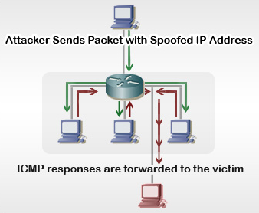
Smurf Attacks
Uses IP spoofing and broadcasting to send a ping to a group of hosts on a network
When a host is pinged it sends back ICMP message traffic information indicating status to the originator
Once a broadcast is sent to the network,
all hosts will answer back to the ping
which results in an overload of the
network and target system
Prevent this type attack to prohibit
ICMP traffic on the router

Slide 26
ICMP Tunneling
ICMP can contain data about timing and routes and packets can be used to hold information that is different from the intended information
This allows ICMP packet to be used as a communications channel between two systems
That channel can be used to send Trojan horses and other malicious packets
Way to prevent this attack is deny ICMP traffic to your network

Slide 27
Questions???

